Slide 1
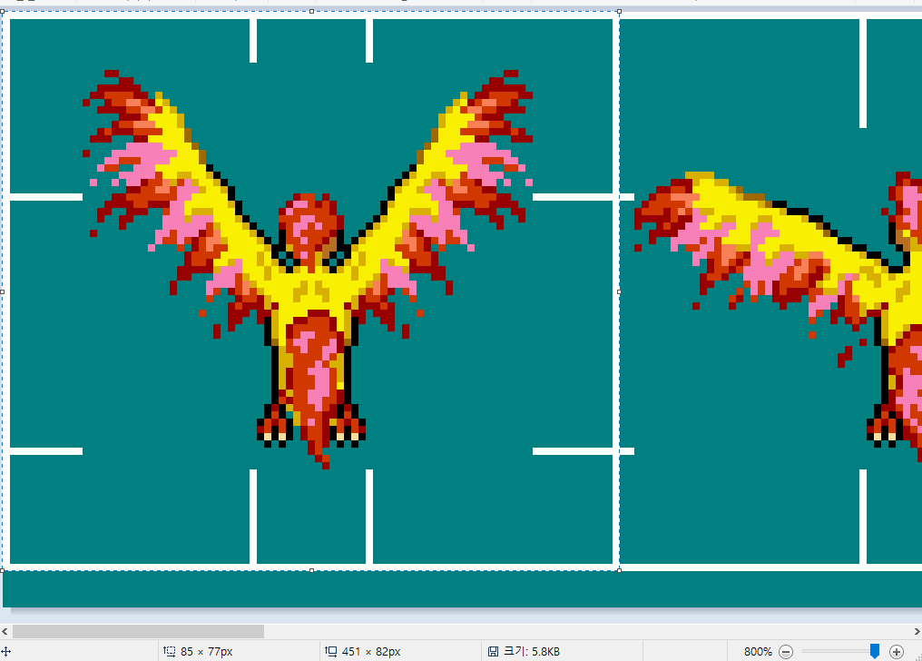
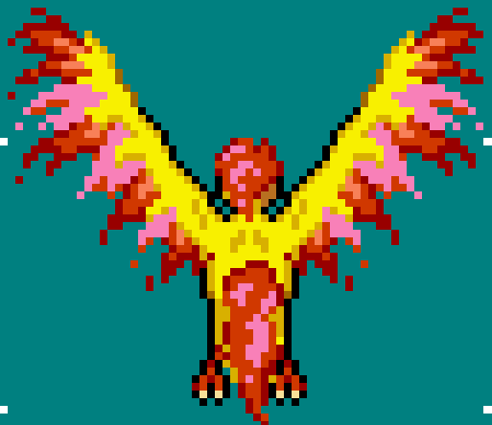
rectImage
{ 0, 0, 85, 77 }
{ 85-1, 0, (85-1)+85, 77 }
HDC
r
bodyDrawPoint
[ rectDraw ]
drawSize
rectBody
(from bodySize)

